Slide 1
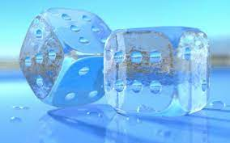
Starter task:
Roll the dice and break the ice
If you could have a super power what would it be and why?
If you could travel anywhere in the world where would you go and why?
If you could only eat one food for the rest of your life what would it be?
What is your favourite sport to do and to watch?
What are you currently watching/listening too/ reading?
If you were a colour what would you be and why?

Slide 2

Google classroom code:
bdt6wuc

Slide 3
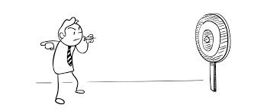

Learning Intentions:
Today we are focusing on the Jewish idea of God
Success Criteria:
By the end the lesson you will be able to:
. Explain at least three key ideas about the Jewish concept of God

Slide 4
Judaism
Beliefs
• beliefs about God
• nature of human beings: yetzer tov; yetzer harah; free will; suffering
• beliefs about Covenant
• judgement; the Messiah; the Messianic Age; Olam Ha’ba
Practices
• living according to the Commandments
• Rosh Hashanah; Yom Kippur
• worship: Shabbat; synagogue

Slide 5
God?

Slide 6
But what or who is God?
“Through the history of the universe and in every civilization, people have thought there has to be more to life than just what we can physically see and touch.
A belief in a god or gods is a naturally occurring idea and for many there is a need to be a belief or view that something more powerful or transcendent exists, on which many build their lives on.” Anon

Slide 7
But what or who is God?
“Through the history of the universe and in every civilization, people have thought there has to be more to life than just what we can physically see and touch.
A belief in a god or gods is a naturally occurring idea and for many there is a need to have to believe that something more powerful or transcendent exists.” Anon
Lets consider the 5 words/phrases that are underlined. What do they actually mean? Take a few minutes to think about each one and discuss your ideas, then I will ask people to share their thoughts.

Slide 8
more to life
physically see and touch.
naturally occurring idea
there is a need
transcendent

Slide 9

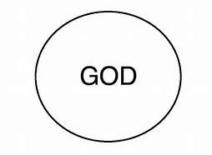
Judaism teaches that God has certain characteristics.
One of the most important is Monotheism.
The nature of God
Monotheism is the belief in one God
Mono = One
Theism = Belief in the existence of God.

Slide 10
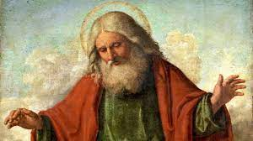
It is very difficult to describe God, because everyday language is always about ordinary things but God is not ordinary.
God is ‘holy’ meaning special, separate and different.
Because this God is impossible to describe in words, his name is very important and only used with great respect.

Slide 11
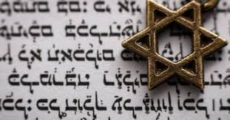
In the Hebrew scriptures that name is written as JHWH, since Hebrew script originally contained no vowels
This is also why his full name is not always written down.
Often G-d is written instead.

Slide 12
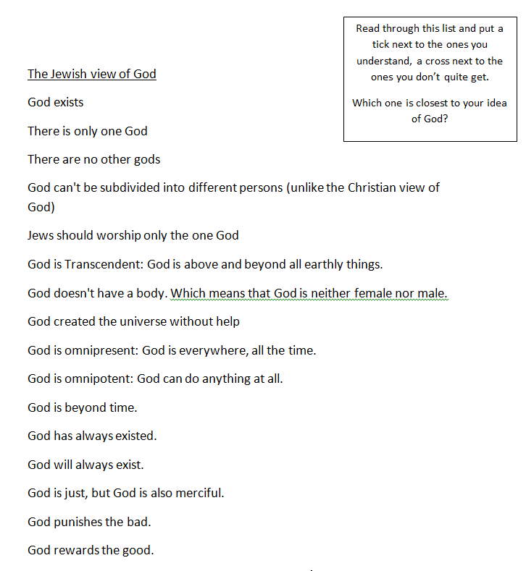
The Jewish faith has many ways of thinking about God.
Take a look at the sheet and tick or cross as asked.
Stick this into your jotter

Slide 13
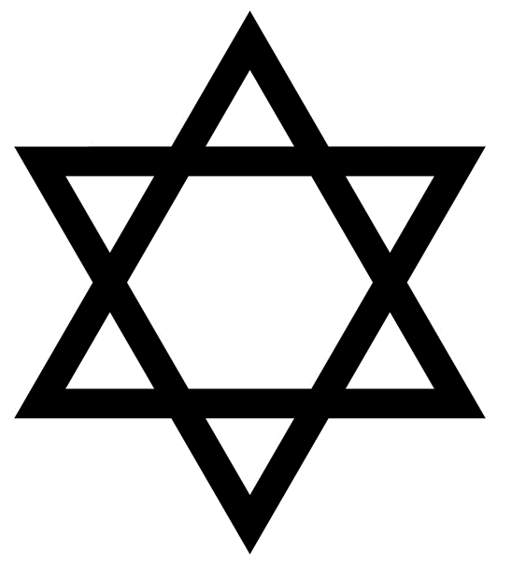
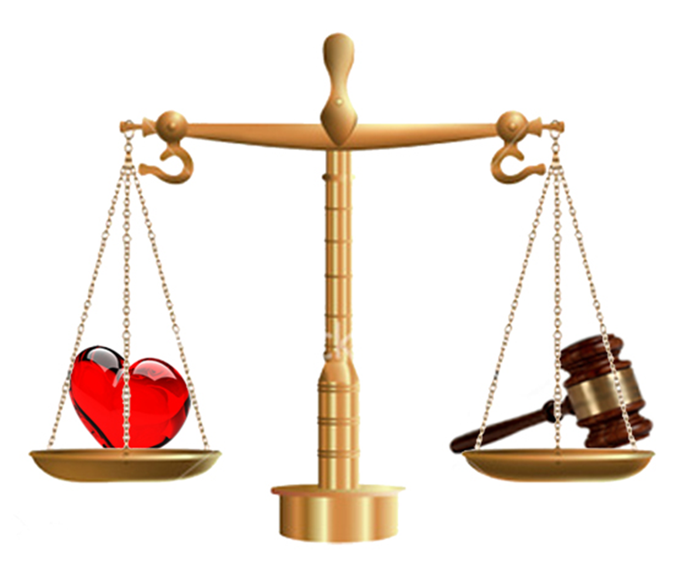
The names of God
In Judaism the following are the most popular characteristics used to describe God.
Omniscient: All Knowing.
Omnipresent: All present.
Omnibenevolent: All loving.
Omnipotent: All powerful.
Eternal: Has always been and will always be.
Just and merciful: Fair but loving.
Key words

Slide 14
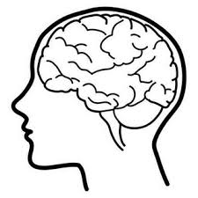
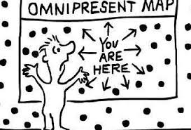
12 minutes
For each of these words create a picture to help you remember it.
It could simply be an object or an emoji or a certain colour or shape.

